Slide 1


About National
Self-Care Week
(16 – 22 November)

Slide 2
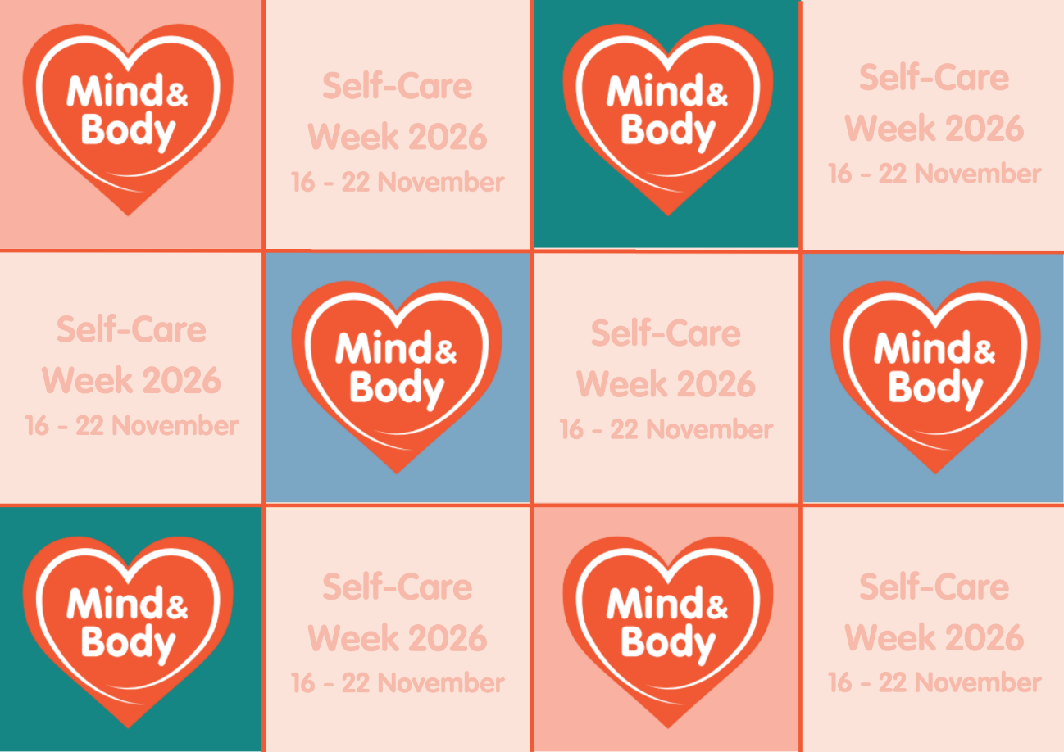
National Self-Care Week
A national awareness week focusing on embedding support for self-care across communities, families and generations
Organised by the Self-Care Forum since 2011
800+ organisations participate each year
Supports people’s understanding of self-care
Power of many voices joining under 1 message
2025 theme is Mind & Body

Slide 3

What is the Self-Care Forum?
Small UK Charity – 17 board members + 1 employee
Aim - further the reach of self-care and embed it in daily life
Raises awareness of self-care
Produces free evidence-based resources for health organisations and health professionals
Shares best self-care practise
Organises National Self-Care Week
Conducts self-care research to understand self-care attitudes and behaviours

Slide 4



What is self-care?
Self-care is the actions that individuals take for themselves, on behalf of and with others in order to develop, protect, maintain and improve their health, wellbeing or wellness.
(Self-Care Forum definition of self-care)

Slide 5

Self-care is not “no care”
Self-care is about individuals understanding and practicing activities that protects their physical health and wellbeing
Self-care does not mean abandonment, it is supported care, empowerment and control
People mustn’t feel or be made to feel like they cannot seek help and support from health professionals

Slide 6


Practising Self-care helps you and your family
  Make exercise part of your routine
  Ensure you don’t miss screening appointments
  Try to eat healthily
  Quit smoking
  Be aware of symptoms of ill health and how long they normally last and understand when you should seek professional help
  Stay connected to friends and family
  Don’t be afraid to ask for help from friends, family or health services

Slide 7
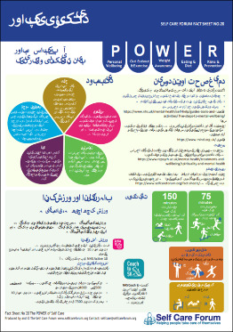
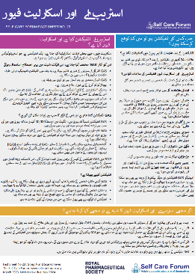
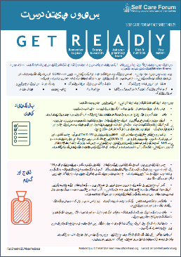
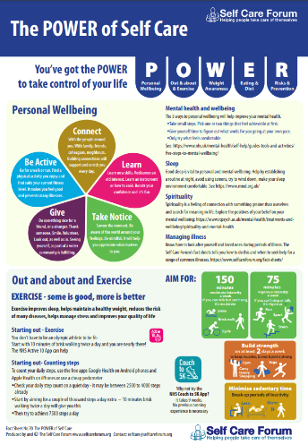
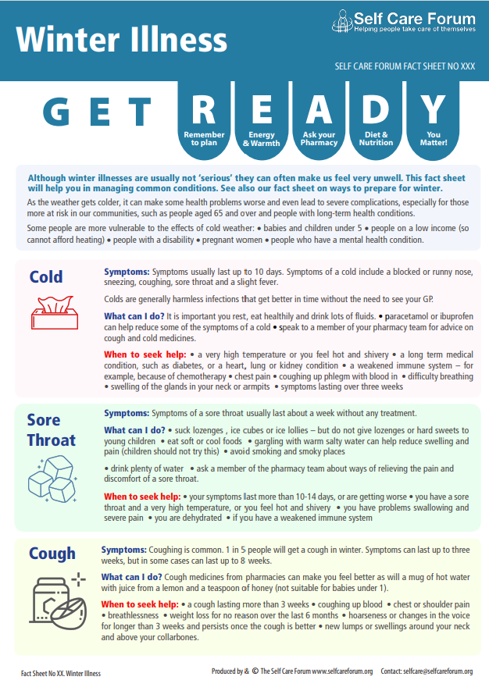
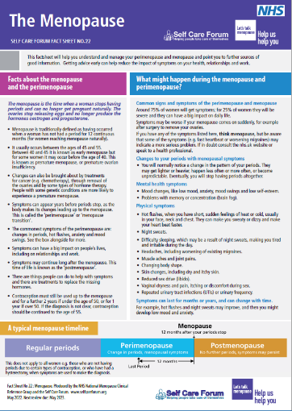
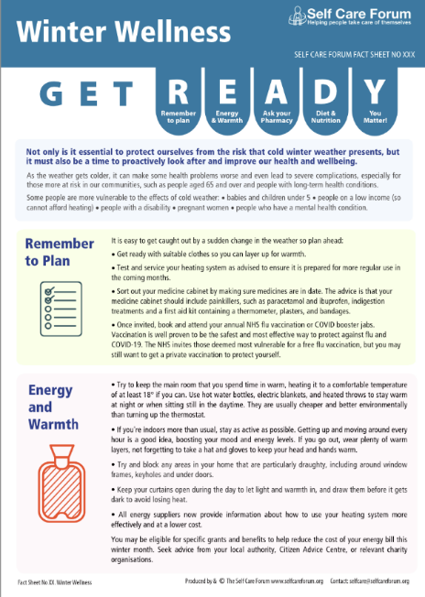
Self-care forum’s Self-care fact sheets
Helps people understand how long symptoms last, and the red flags
27 Self-Care Aware Fact Sheets
Trustworthy health information
Common ailments and food supplement focused

Slide 8

Self-care for life

